Slide 1
METHODS / FUNCTIONS & METHOD OVERLOADING

Slide 2


Slide 3
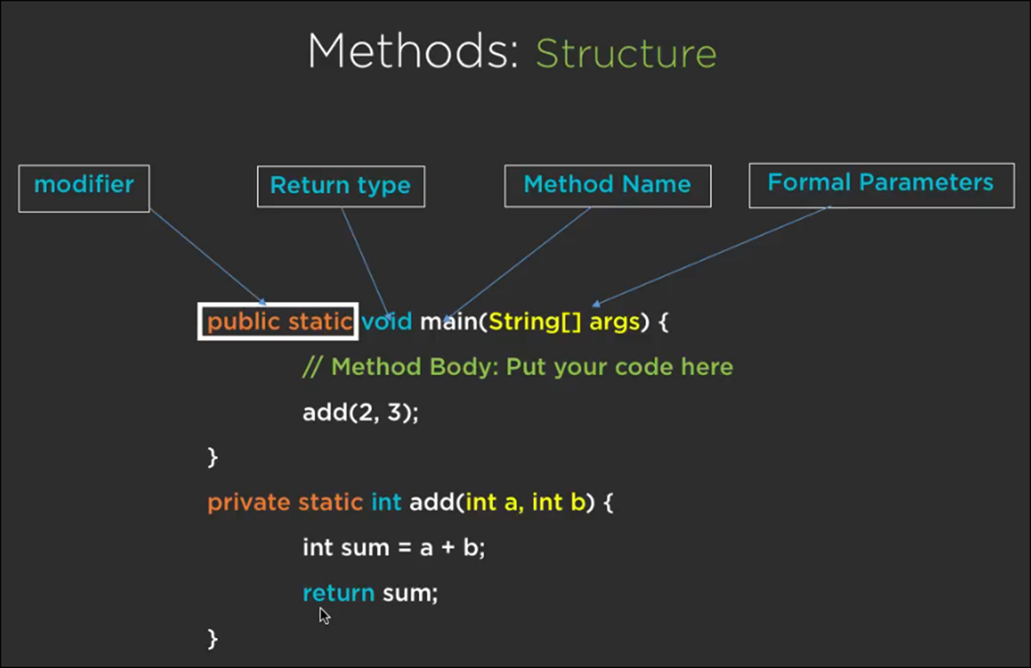

Slide 4
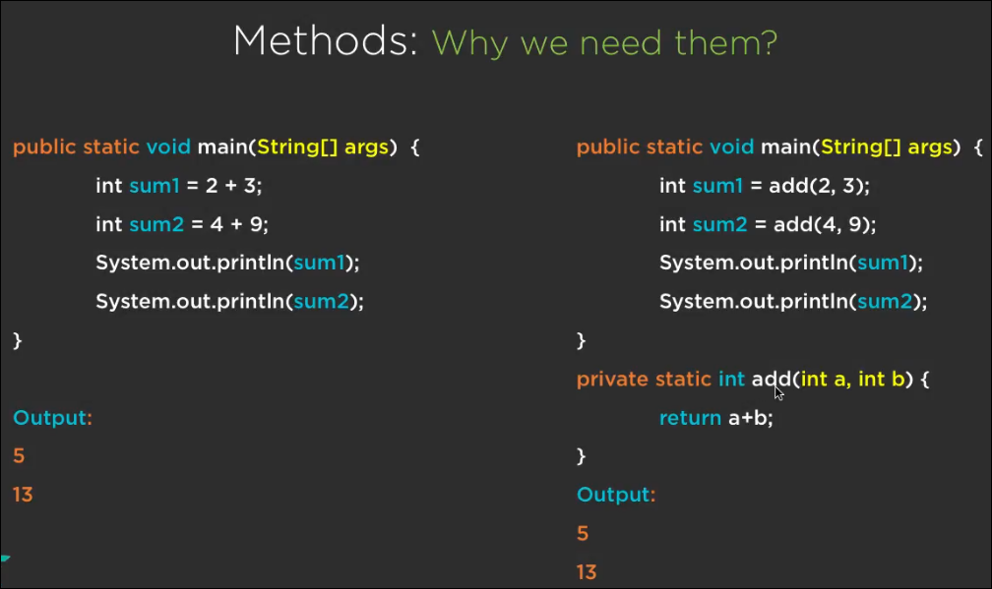

Slide 5
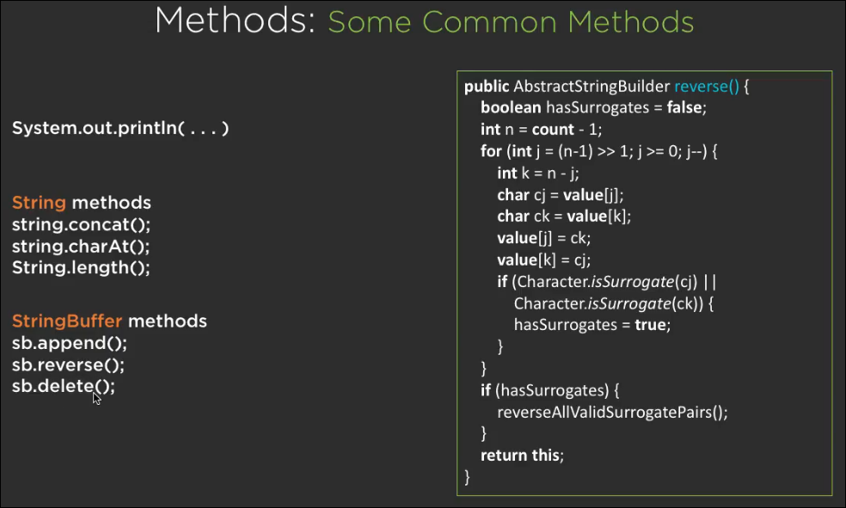

Slide 6
